Slide 1
Additional Findings
DBS Study

Slide 2
Overview
Vowel Duration
Artic Rate vs. Speaking Rate
Task Effects (Baby Birds vs. BBAP)
Buy Duration

Slide 3
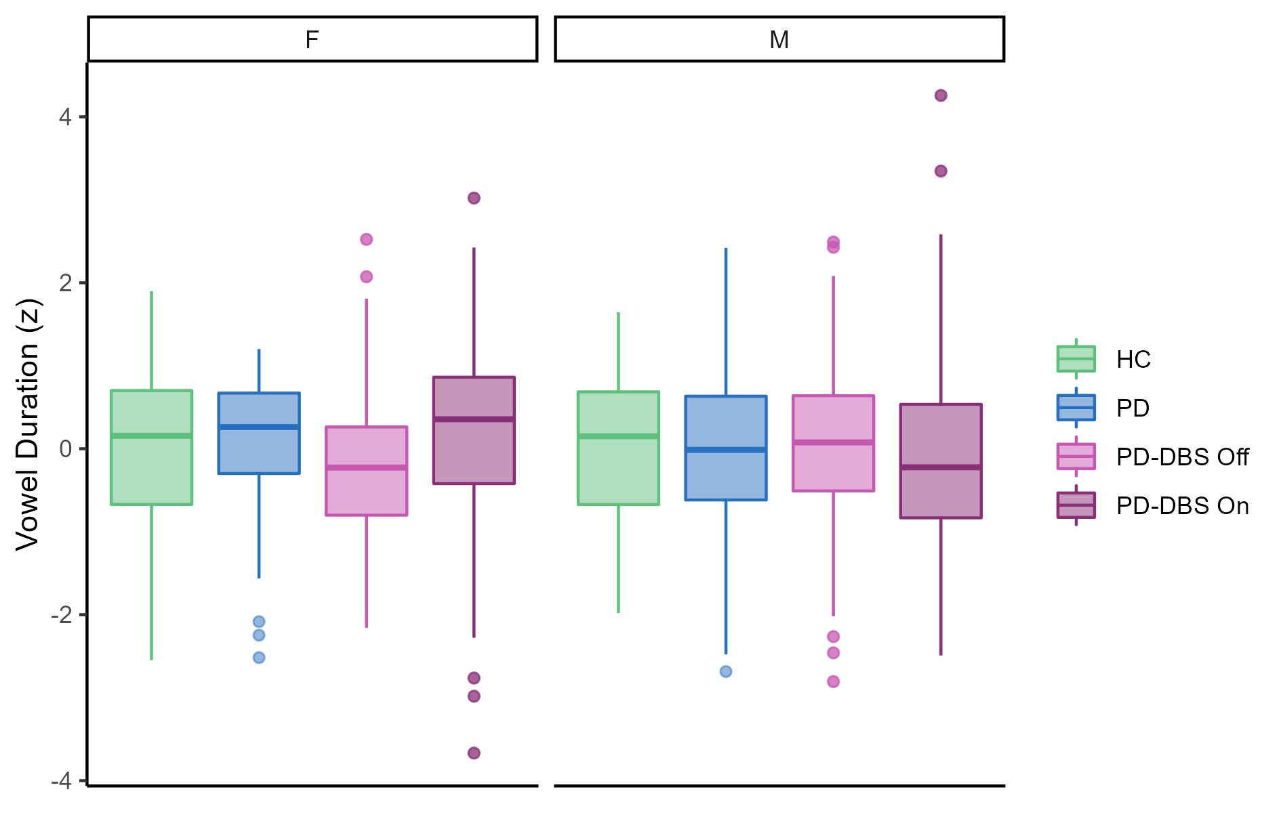
1. Vowel Duration
I didn’t statistically look at this relationship.
But, it appears that the female speakers increased their vowel duration in the DBS On condition, which likely allowed them to achieve statistically greater vowel dispersions.

Slide 4
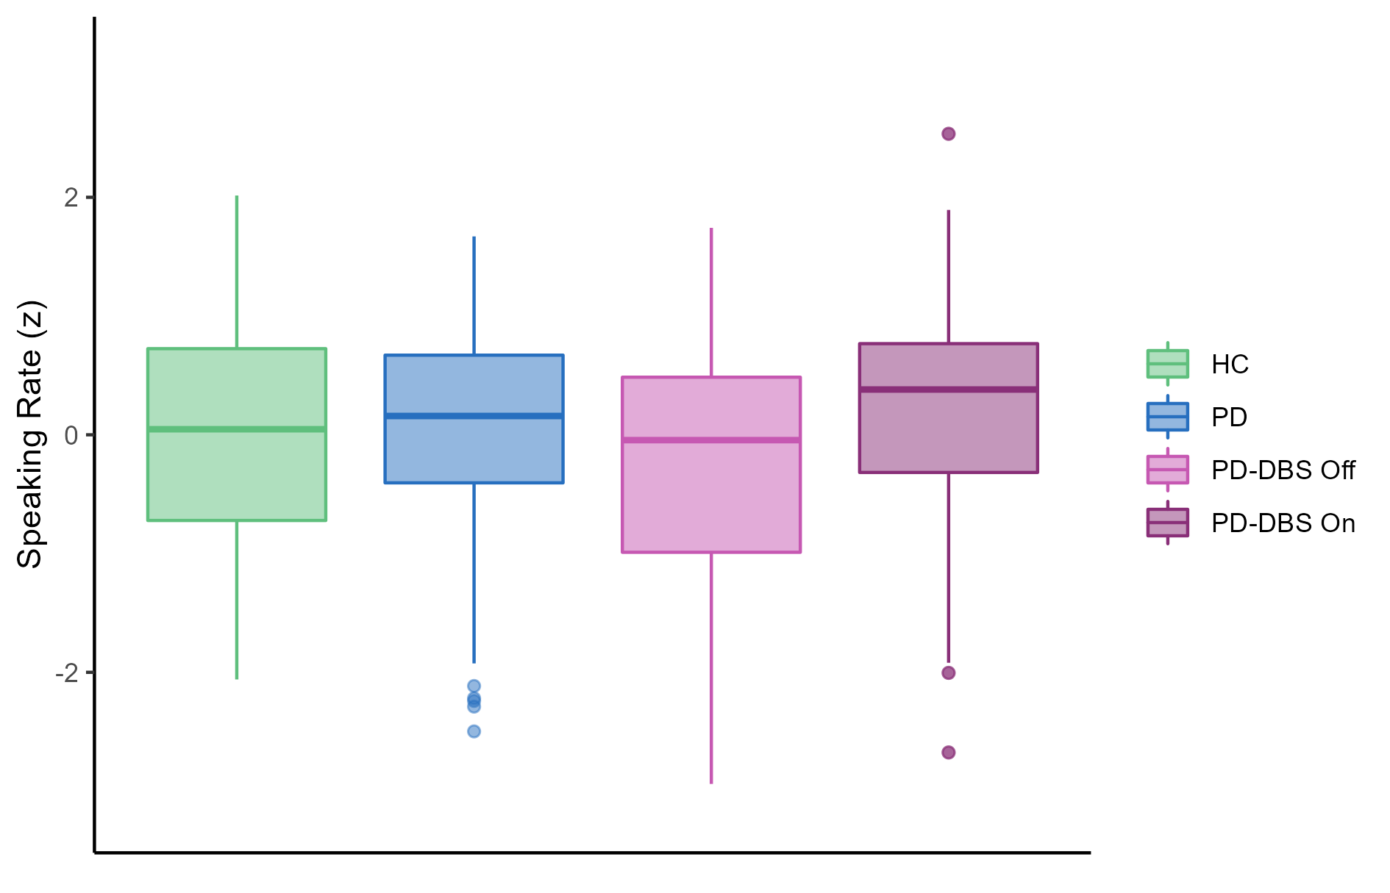
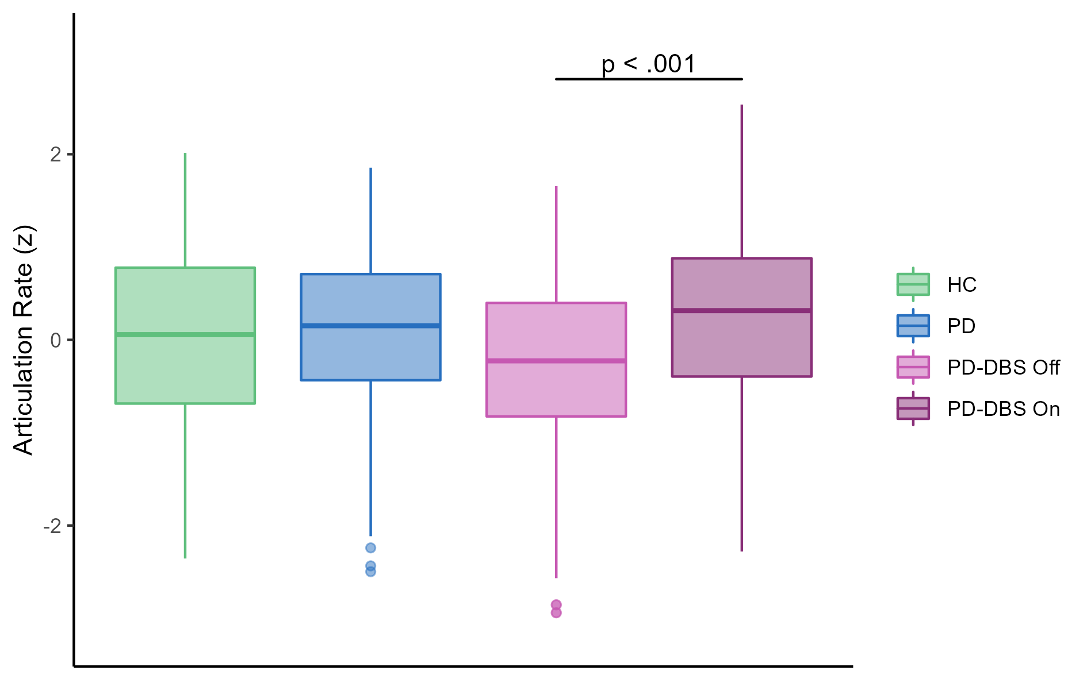
2. Articulation vs. Speaking Rate
Speaking Rate (The baby birds…)
Articulation Rate
There does not appear to be a large difference between the two measures. Only for the more severe speakers there were many breath groups within the phrase.

Slide 5
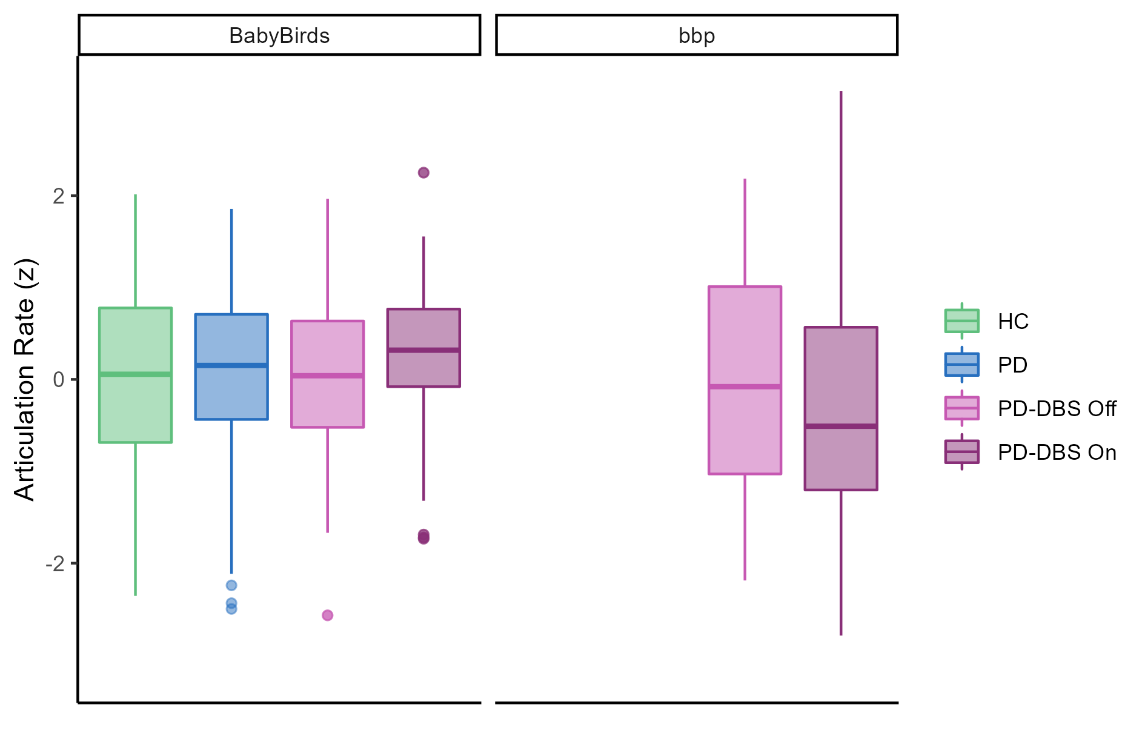
3. Task Effects (Baby Birds vs. BBAP)
*
No stats have been run on BBP
But it looks like there is a clear task effect.
This is likely why we are seeing shallower F2 slopes in the on condition

Slide 6
3. Task Effects (Baby Birds vs. BBAP)
*
No stats have been run on BBP
But it looks like there is a clear task effect.
This is likely why we are seeing shallower F2 slopes in the on condition

Slide 7
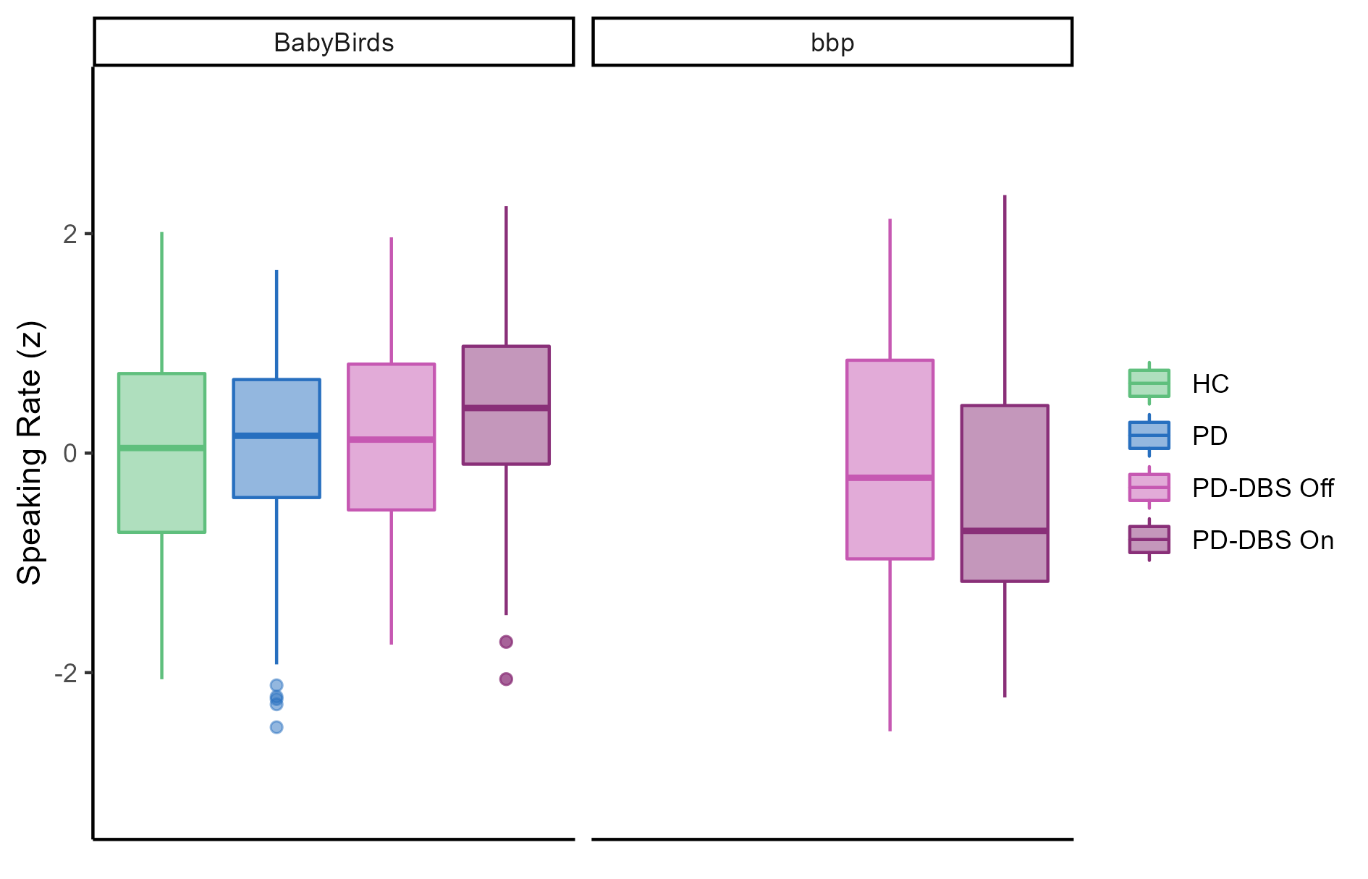
3. Task Effects (Speaking Rate)
Similar findings for Speaking Rate

Slide 8
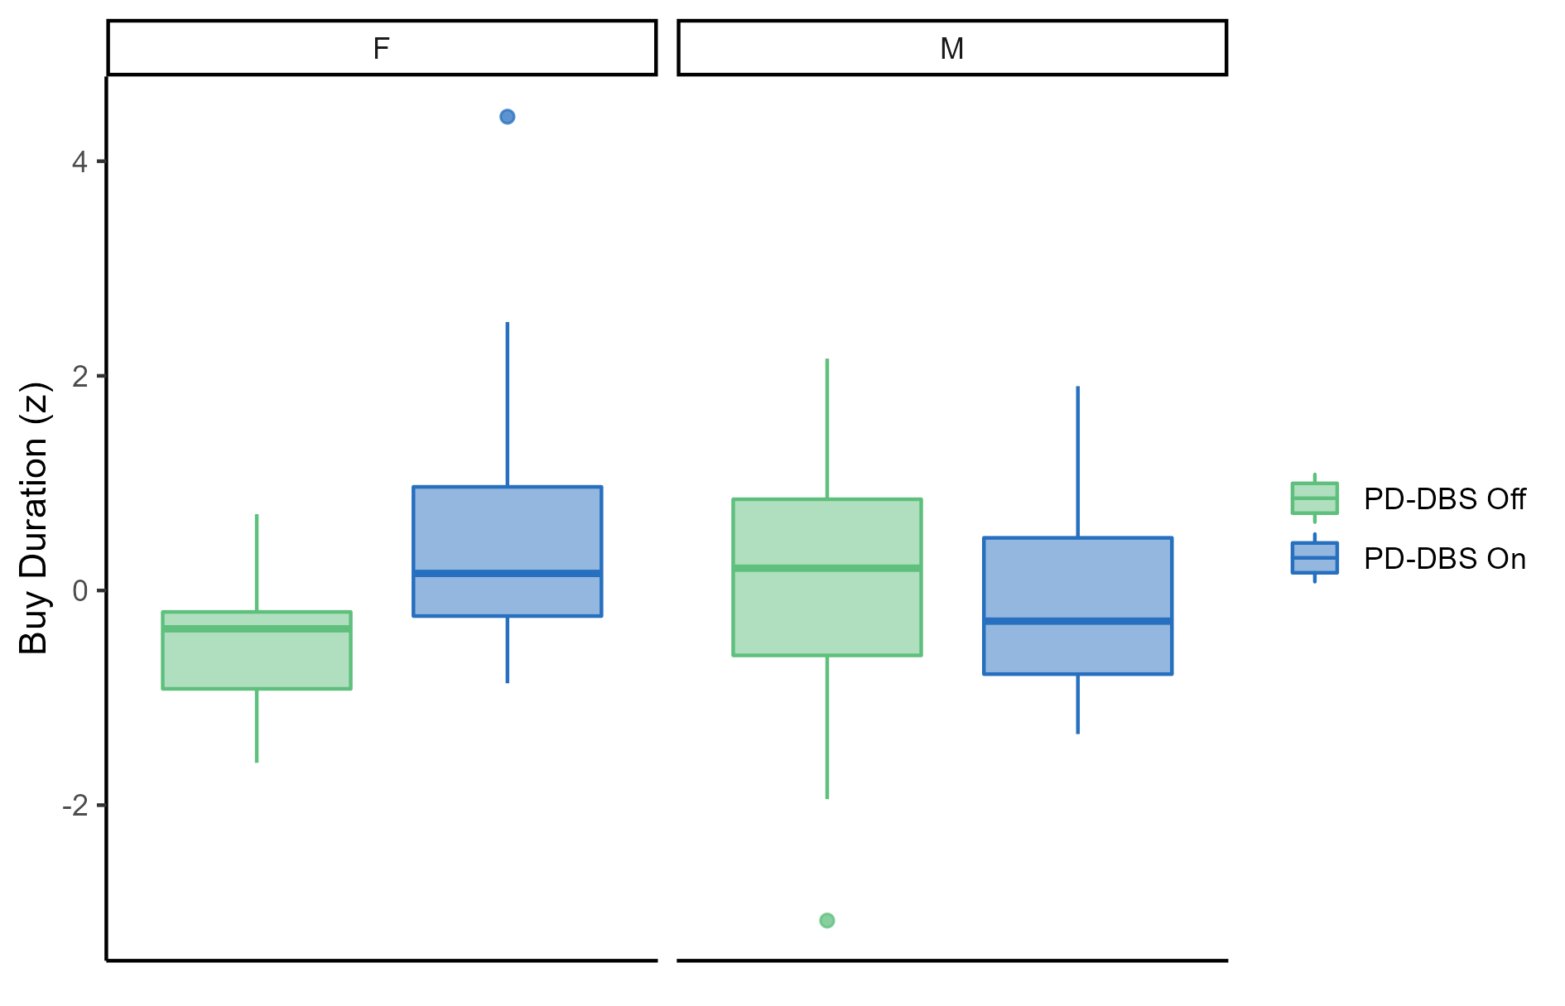
4. Buy Duration
The females tended to have longer Buy duration, which is likely why their F2 slopes were statistically shallower

